Slide 1
Spaced Repetition and Mnemonics Enable Recall of Multiple Strong Passwords
Jeremiah Blocki, Saranga Komanduri, Lorrie Cranor, Anupam Datta
Presented by Lihua Ren

Slide 2






Motivation
…

Slide 3


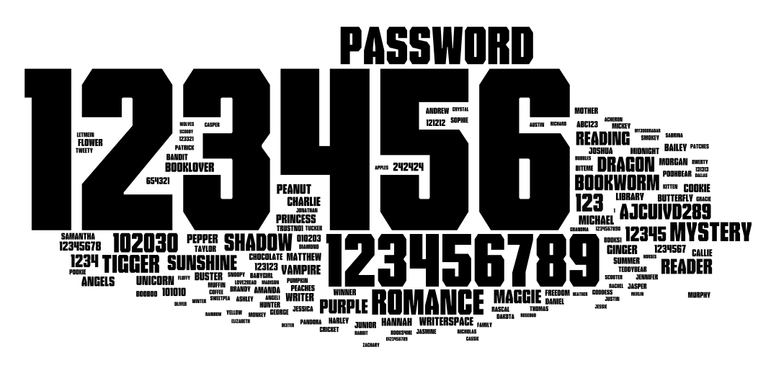
Usability Problem
Too many password → users select weak password, reuse passwords or frequently reset passwords.
Insecure! Painful effort!

Slide 4







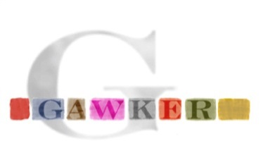

Security Problem
Password breaches at major companies have affected millions of users.

Slide 5
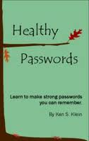
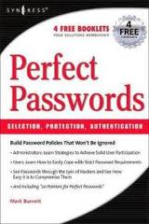
Traditional Security Advice
Use numbers and letters
Use special symbols
Don’t Reuse Passwords
Don’t use words/names
Not too short
Don’t Write it Down
Use mix of lower/upper case letters
Change your passwords every 90 days

Slide 6
Existing works
The password strengthening mechanism of Bonneau and Schechter
  How: User authenticates by typing in old password + a random character or word.
  Limitation: requiring the user to memorize a new random character/word to append to his password
Password Composition Policies
  How: restrict the space passwords that users can choose.
  Limitation: negatively effect usability & adverse security effects

Slide 7
This work
Conducted a user study:
  Participants were asked to memorize several randomly generated person-action-object (PAO) stories.
Questions to answer:
  Spaced Repetition
    Can users recall multiple PAO stories by following spaced repetition schedules?
    Which schedules work best?
  Mnemonic Advantage
    Does the PAO mnemonic technique improve recall?
  Interference Effect

Slide 8
Background knowledge

Slide 9



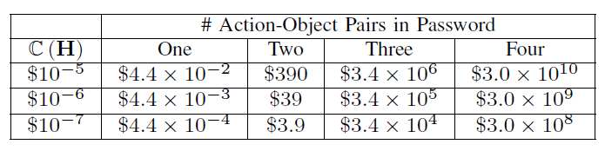
Background: Security Against Offline Attacks
Offline dictionary attack
Cost of an Offline Attack
By comparing H(pw) with guessed H(pw)
brute-force attack

Slide 10
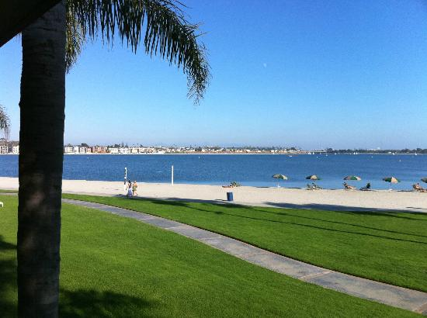
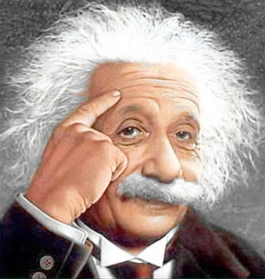

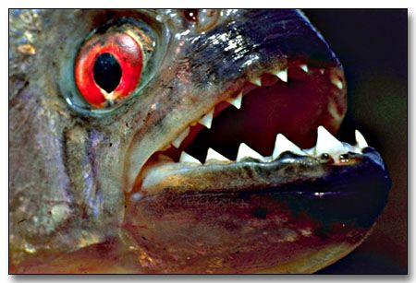
i.e. Person-action-object (PAO) stories

Slide 11
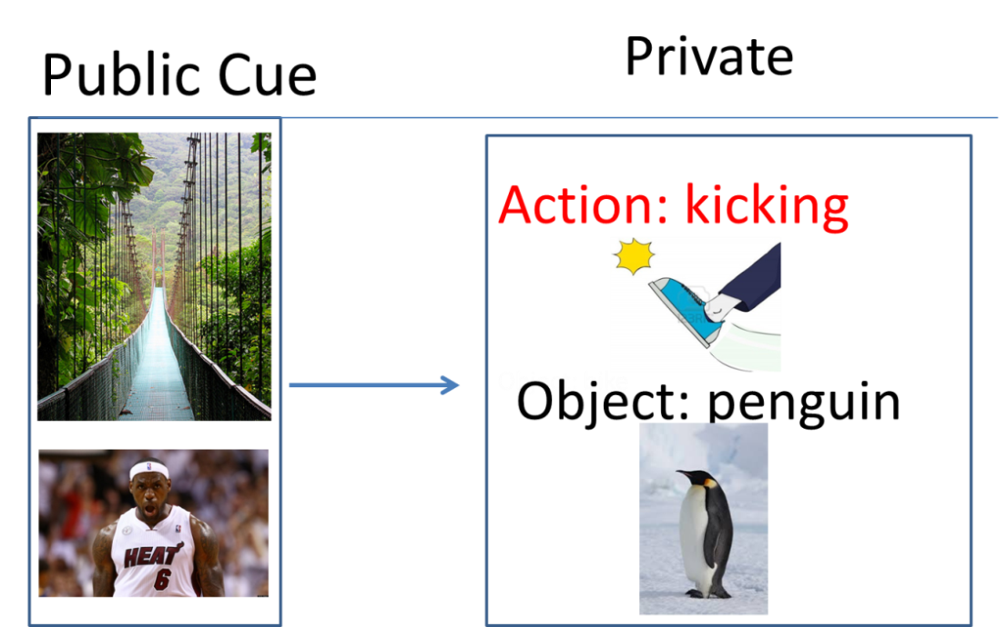
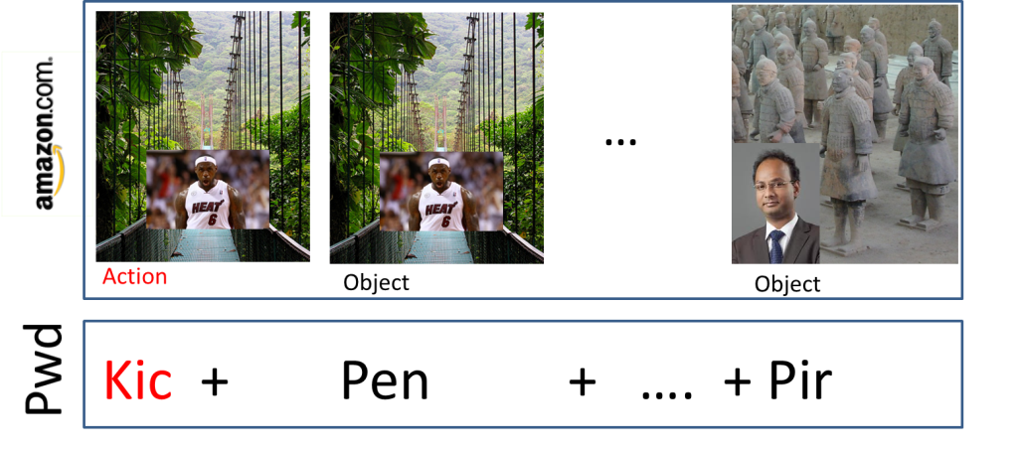
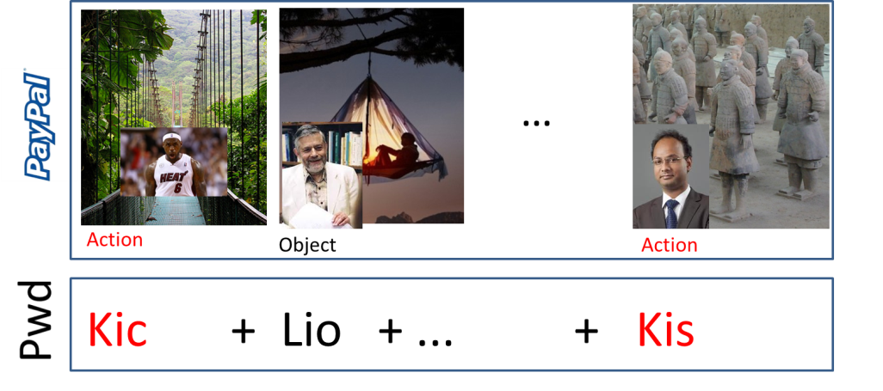
Background: Shared Cues
Combinatorial Design: Each pairs of accounts has at most 𝛄 secret stories in common.
Source: Naturally Rehearsing Passwords [BBD13]

Slide 12



Background: Shared Cues
PAO Stories | #Passwords | Security
4 | 14
Adversary with one password is unlikely to crack any other password
7 | 75+
15 | 75+
43 | 75+

Slide 13
Study protocol

Slide 14


Recruitment
578 participants completed initial memorization phase

Slide 15
User Study Protocol
Memorization Phase (5 minutes):
  Participants asked to memorize four randomly selected person-action object stories.
Rehearsal Phase (120+ days):
  Participants periodically asked to return and rehearse their stories (following rehearsal schedule)

Slide 16
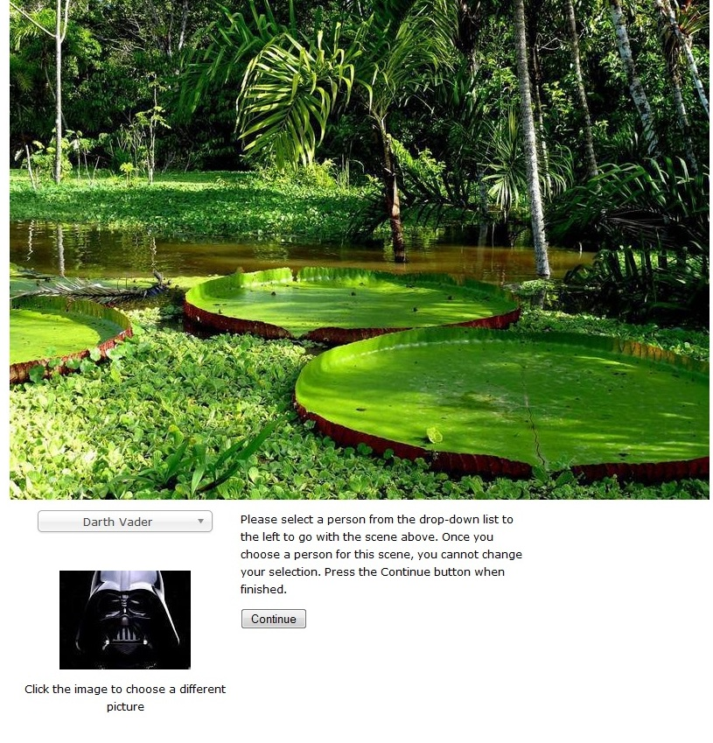
Memorization Phase – Mnemonic group

Slide 17
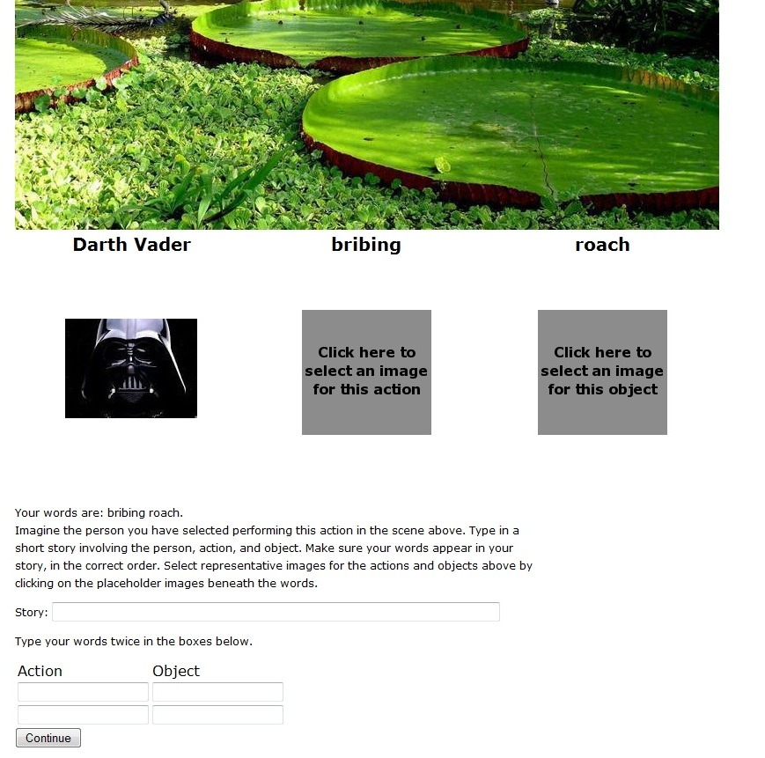
Memorization Phase – Mnemonic group

Slide 18
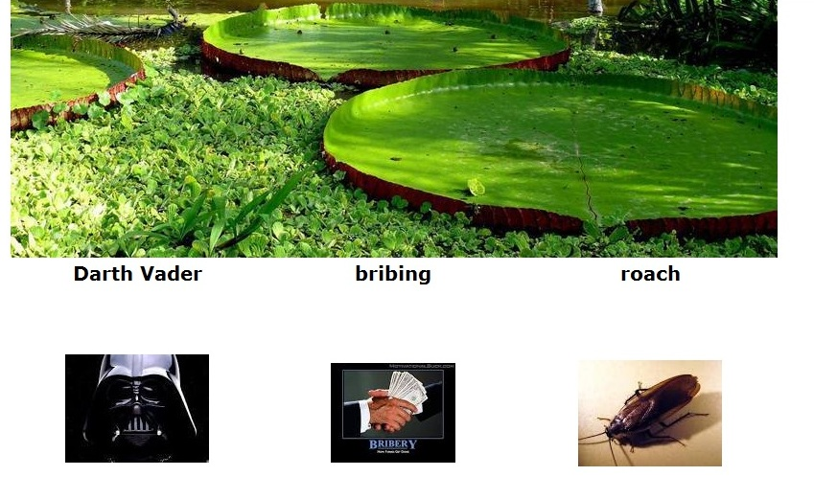
Memorization Phase – Mnemonic group

Slide 19
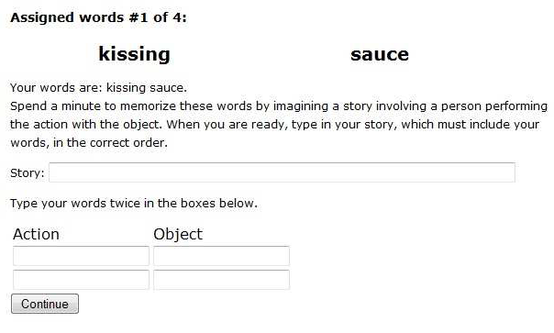
Memorization Phase – Text group

Slide 20
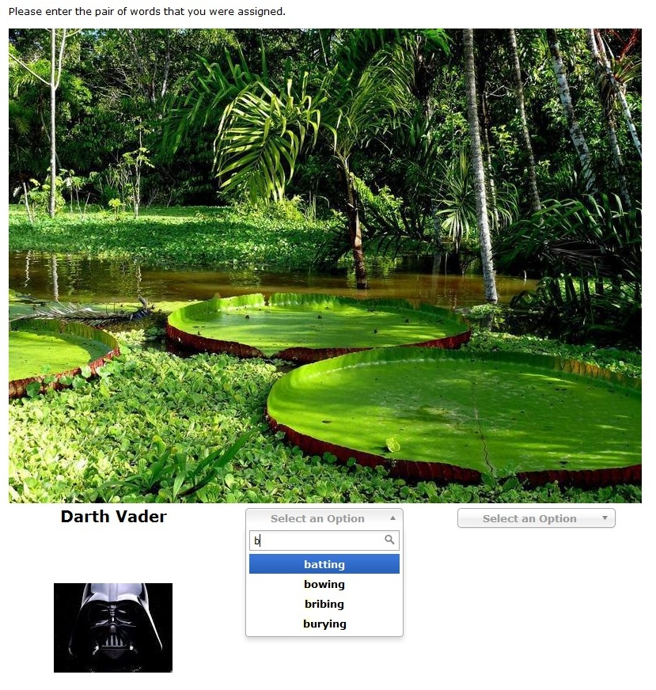
Rehearsal

Slide 21
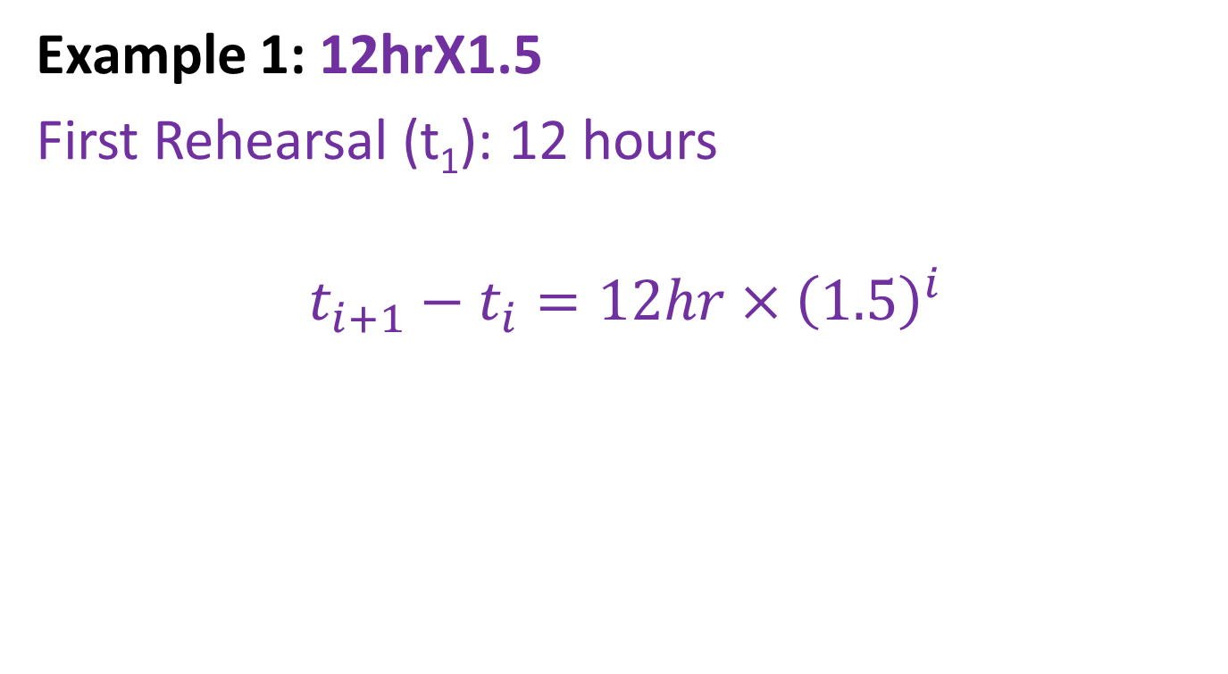
Rehearsal Schedules
Final Rehearsal (t₁₀): 157 days
2
4
6
7
10
0
1
3
5
8
9
Day:0 16 32 48 64 80 96 112 128 144 160

Slide 22
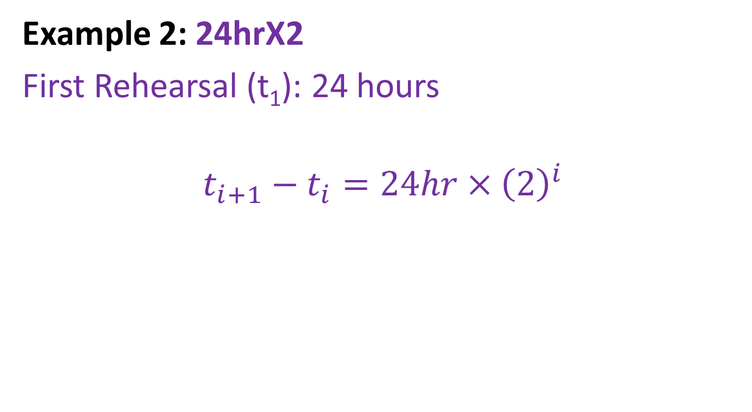
Rehearsal Schedules
Example 2: 24hrX2
First Rehearsal (t₁): 24 hours
$$t_{i+1}−t_{i}=24hr×{\left(2\right)}^{i}$$
Final Rehearsal (t₇): 127 days
2
4
6
7
0
1
3
5
Day:0 16 32 48 64 80 96 112 128 144 160

Slide 23
Rehearsal Schedules
Rehearsal#/ Schedule | 1 | 2 | 3 | 4 | 5 | 6 | 7 | 8 | 9 | 10 | 11 | 12
12hrx1.5 | .5 day | 1.75 | 4.2 | 8.2 | 14.7 | 24.7 | 40.7 | 64.7 | 101.7 | 157.7 | N/A | N/A
24hrX2 | 1 day | 3 | 7 | 15 | 31 | 63 | 127 | N/A | N/A | N/A | N/A | N/A
24hrX2+2Start | .1 day | .6 | 1.6 | 3.6 | 7.6 | 15.6 | 31.6 | 63.6 | 127.6 | N/A | N/A | N/A
30minX2 | .5 hr | 1.5hr | 3.5hr | 7.5hr | 15.5 hr | 1.7 day | 3.7 | 7.7 | 15.7 | 31.7 | 63.7 | 127.7

Slide 24
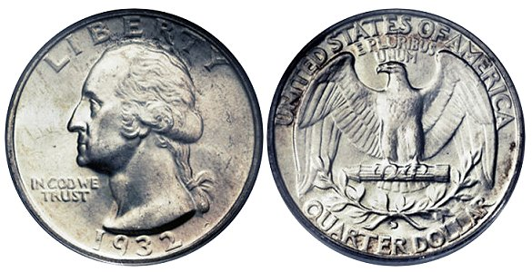


Incentives
Memorization Phase ($0.5)
Rehearsal Phase ($0.75 each)
  Encourage participants to return
  Discourage Cheating

Slide 25
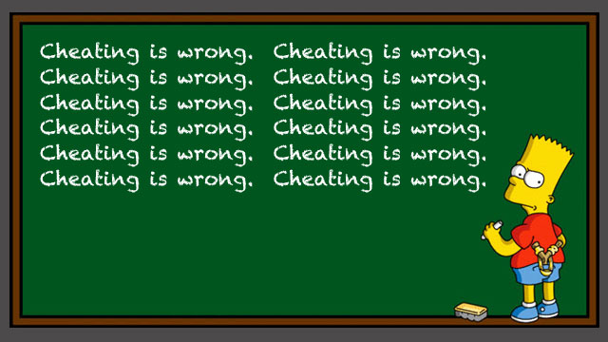
Do Not Write Down Your Words
“…we ask that you do not write down the words that we ask you to memorize.”
“You will be paid for each completed rehearsal phase --- even if you forgot the words.”
“Important: …do not write down the words”
“You will be paid for each completed rehearsal phase --- even if you forgot the words.”

Slide 26
Study Conditions
Interference
Condition | Comment
m_24hrX2+2Start_1 | 1 PAO Story
m_24hrX2+2Start_2 | 2 PAO Stories
m_24hrX2+2Start_4 | 4 PAO Stories
Compare Rehearsal Schedules
Mnemonic vs Text
Condition | Comment
t_24hrX2+2Start_4 | Text condition/No Cues
m_24hrX2+2Start_4 | Mnemonic Condition
Condition | Comment
m_24hrX2_4 | 24 hour base
m_24hrX2+2Start_4 | Two Extra Rehearsals on Day 1
m_30minX2_4 | 30 min base
m_12hrX1.5_4 | Growth Rate: 1.5x

Slide 27
Follow Up Survey
Problem
  Some participants did not return to rehearse their stories.
Hypothesis:
  The primary reason:
    too busy
    did not get follow up message in time
    not interested in interacting with them outside of the initial Mechanical Turk task.
  Not because they would not remember the story.
How to prove?
  Send a follow up survey to all not return.

Slide 28
Results

Slide 29
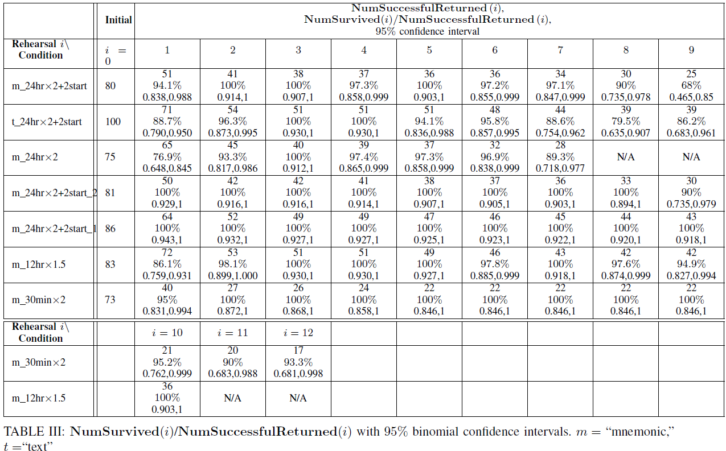

Slide 30
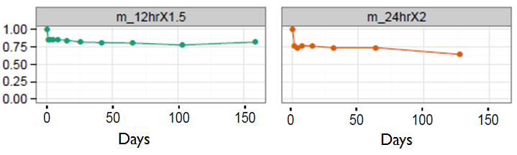
Rehearsal schedule
Survived(i)/Returned(i)

Slide 31
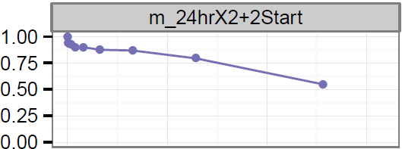
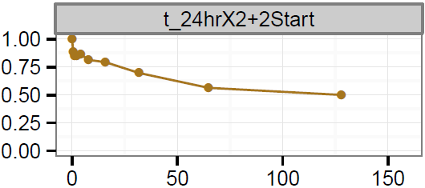
Text vs Mnemonic
Advantage is statistically significant
Advantage is not statistically significant
Survived(i)/Returned(i)

Slide 32
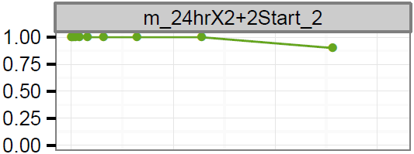
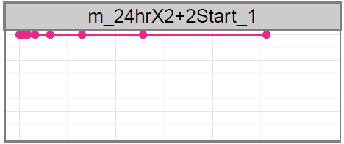
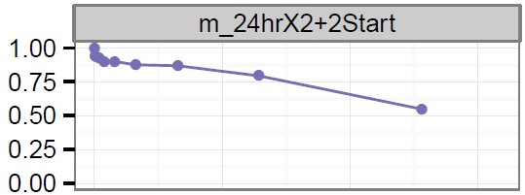
Interference
Days
Days
Survived(i)/Returned(i)
Interference Effect was Statistically Significant

Slide 33
Findings
Spaced Repetition
  Yes, participants did remember multiple PAO stories!
  Winning Schedule: 12hrX1.5
Mnemonics
  Short Term: Benefit is statistically significant
  Long Term: Rehearsal schedule was only significant factor
Interference
  Benefit: Memorize one story at a time
  Future Work: Causes of interference

Slide 34
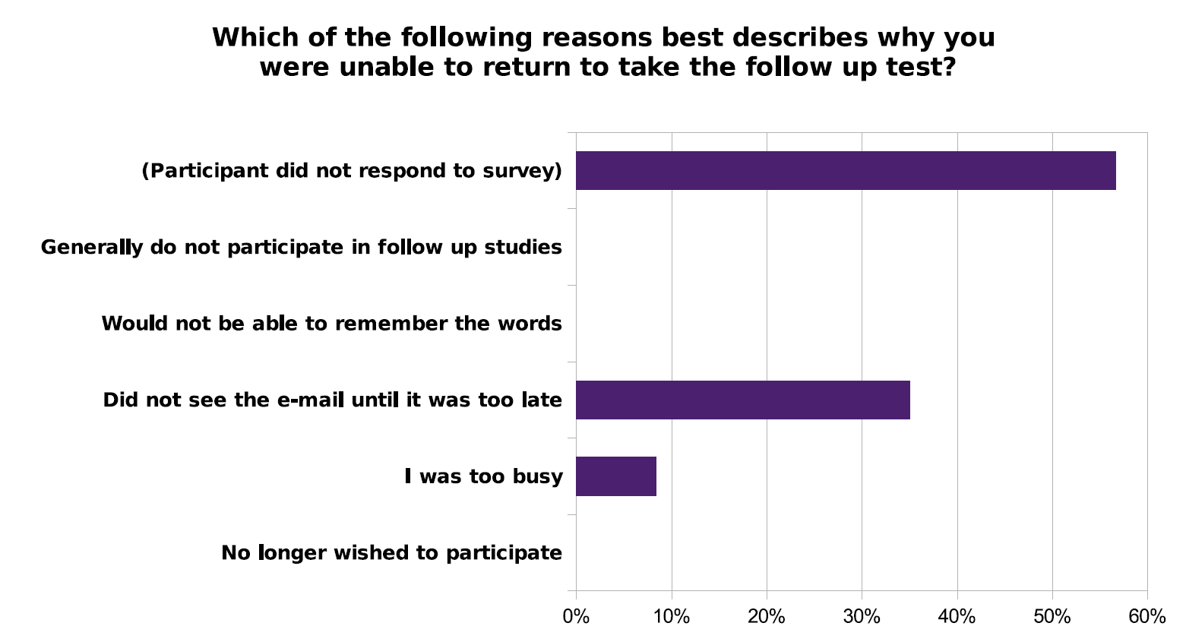
The Follow Up Survey: Dropped Participants
No participant self-reported that they didn’t return because the stories were too difficult to memorize.

Slide 35
Limitations
The follow up survey
  Only conducted among 61 participants not return to the first rehearsal
There is only one experiment (t_24hrX2+2Start) for text group.
Assumption
  Users not to participate the flow up survey → not because the users cannot remember the story.

Slide 36
Conclusion
Spaced Repetition and Mnemonics Enable Recall of Multiple Strong Passwords
…
…

Slide 37
Quiz
What are the two phases of the user study?
Why the authors performed a follow up survey?
According to the results of the user study, which rehearsal schedule performs the best?

